Slide 1


TECHNICAL COMMUNICATION (KAS – 301)
UNIT – 1
Language as a tool of Communication
Presented by
Dr. RENUKA
Assistant professor
Applied Science and Humanities
IMS Engineering College, Ghaziabad

Slide 2
What is a Language?
“Language is the expression of ideas by means of speech-sounds combined into words. Words are combined into sentences, this combination answering to that of ideas into thoughts.”
“A language is a system of arbitrary vocal symbols by means of which a social group cooperates.”
Language is a system of words and sounds to communicate ideas in a meaningful way.
The scientific study of language is called Linguistics.

Slide 3
language as a tool of Communication
Language is closely related to people and cannot exist in isolation.
Language is universal, it cannot be denied that it is also specific to individuals.
Our use of language reflects our personality and gives an insight into our thinking.

Slide 4
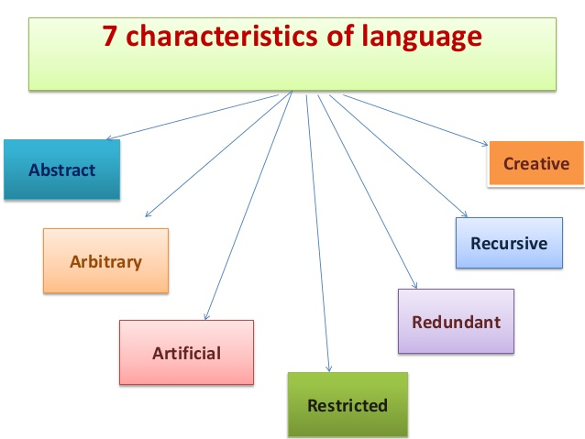

Slide 5
Language is artificial
Language is created by people.
It does not exist in isolation or outside the minds of people.
It is created by humans based on their needs.
There is no natural connection between a symbol and its meaning.
Humans attach meanings to words according to needs, and modify these meanings according to changing needs.

Slide 6
We are not born with language.
We learn it through practice.
So, language is not genetic, but artificial.
Every language is a man-made system of sounds and graphs.
Each language-society has its own system of sound-graph code
let us take the word ‘ AIDS’, which does not exist until people were infected by this contagious disease.

Slide 7
language is abstract
Language allows us to generalize concepts in our brain.
A word could represent different ideas at different times.
We use this mental ‘definition’ to understand what a thing is, when we see it.
This is called abstraction.
Ex. The general concept of ‘Dress’ = “a formal wear”
Situation1: Indian Office = Saree / Suit
Situation 2: American Office = Shirt and Trousers

Slide 8
Language is arbitrary
Language is man-made.
There is no direct relationship between a word and the idea or object it represents. This makes language arbitrary
When language first came into being, a community of people agreed to represent a certain object or idea by a specific sound or symbol.
Example
Table – a piece of furniture with four legs and a wooden plank used for keeping things .
There is no reason why a four-legged creature is called ‘CAT’ in English or ‘Billi’ in Hindi.

Slide 9
language is creative
Language has an ability to generate so many words every day.
Every year innumerable words are added to the dictionary.
As the need arises, a word is created to explain that particular thought & process.
These words can be added by different processes
A) Borrowing ( taking words from other languages such as ‘Boss’ from Dutch.
B) constructing portmanteau words ( words made by combining the sound
meaning of two different words
ex- edutainment = education + entertainment

Slide 10
Language is restricted
Language cannot express our thoughts and feelings exactly and totally.
It needs non-verbal hints to indicate meaning.
So, language is restricted, or, limited.
Example
Think of the school you went to as a child. When you were in school, the building was new and modern. You called it ‘my school’. After many years, it now looks old and worn out. You still call it ‘my school’

Slide 11
Language is redundant
Redundancy means ‘Extra’
We use extra words in sentences, without contributing to meaning.
This happens most, when we speak.
All natural languages were born as spoken language.
So, redundancy is seen
EXAMPLE :
I take this opportunity to announce a meeting together at 3 p.m. in
the afternoon. ( Using excessive words to no purpose)
I announce a meeting at 3 p.m.

Slide 12
Language is recursive
Recursion is the characteristics of language which enables one to generate any number of sentences using the same basic grammatical templates.
It also allows one to express any idea, thought, or feeling using the same finite vocabulary.
It implies that there is no limit to the potential length of a sentence.
Example:
We went to see Mission Mangal, which was based on India’s mars mission, which was launched in 2013, which made India the first Asian country to do so, which made us proud..
In technical communication, it is used in writing Legal texts, like license agreements.

Slide 13
ACTIVITY
Frame the words into the meaningful Sentences
Banter 6. Bout
Bedlam 7. Brevity
Behest 8. Bizarre
Benevolent 9. Beseech
Boisterous 10. Bestow

